Slide 1
Better Together: Text and Context
Team Overview and Individual Progress Report
Melissa Mitchell
07/07/23

Slide 2
Outline
Introduction (2 minutes)
Overall Motivation
Team Overview (4-5 minutes)
Evaluation
Resources / Systems
Project Overview (6-8 minutes)
My Contributions
Current Work / Next Steps
Questions

Slide 3
Introduction – Overall Motivation
How do problems scale with time and complexity?
Text and context
Models become outdated quickly
Scientific output doubles every 9 years
Teams
Evaluation
Dynamic evaluation instead of static benchmark
Propose tasks, metrics, etc
Resources / Systems
Make splits, run models on splits, etc
Make production runs easier

Slide 4
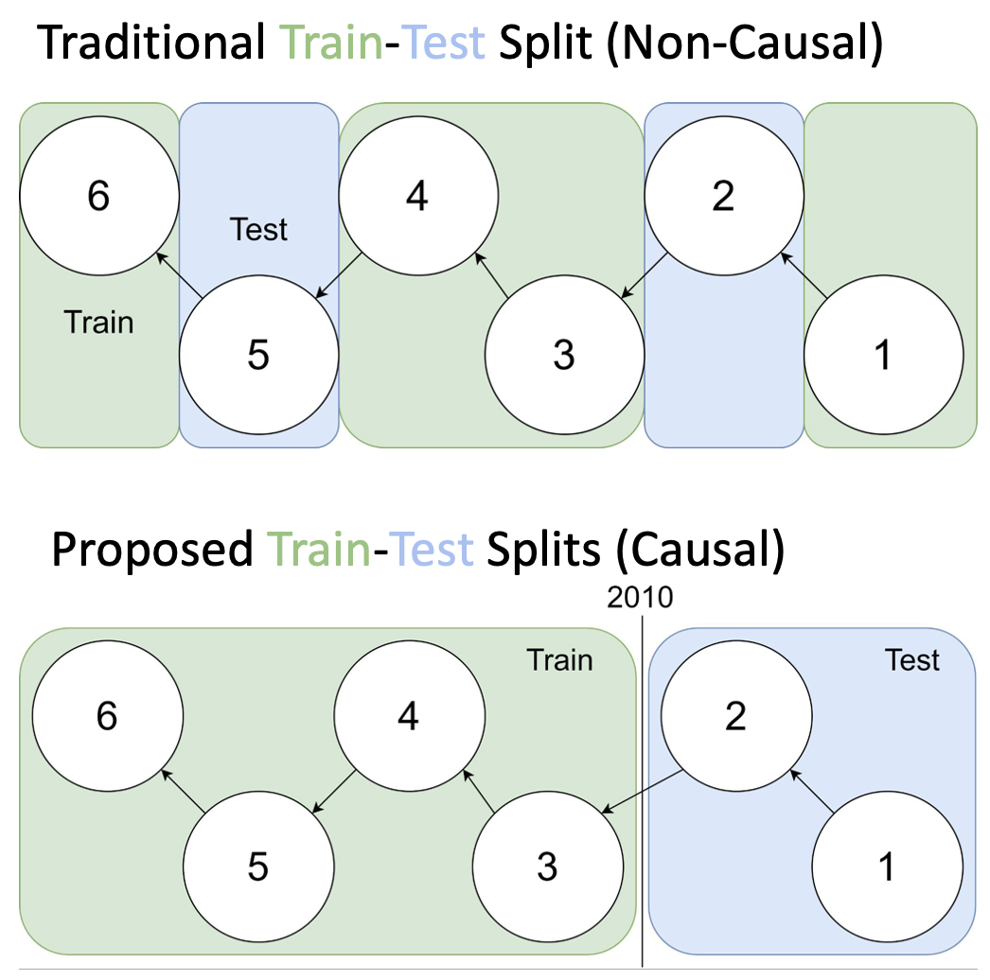
Team Overview – Evaluation
Evaluation that studies scale over time / space
Tasks
Citation recommendation
Citations after k years
Repeat citations
Publication year prediction
Venue prediction
Peer review score prediction
Address drawbacks of current evaluation
Reduce emphasis on SOTA
Treat models as dynamic instead of static

Slide 5
Team Overview – Resources / Systems
Split graph into 100 pieces by time, cumulative graphs
Itself and all previous graphs
Extract graphs and get ProNE embeddings
ProNE embeddings are n x k matrix, node is paper, edge is citation
Cosines in embedding space represents distance in graph
ProNE
Initialize network embeddings as by formulating task as sparse matrix factorization
Enhance embeddings by propagating them in spectrally modulated space
ProNE bottleneck: SVD for sparse graph

Slide 6
Team Overview – Resources / Systems
ProNE
Pre-factorization
Tiling for speed optimization, matmul on GPU (John)
Chebyshev expansion
Use sparse matrix pytorch library to speed up sparse matrix multiplications (Ben)
Reduce memory requirements by limiting number of matrices loaded in code
Final step
Sparse matrix multiplication
Explore GNN vs ProNE
Verify by comparing both for link prediction (document recommendation)
GNN better for generalizability, working with new data
Determine metrics for accuracy, scalability, and cost

Slide 7
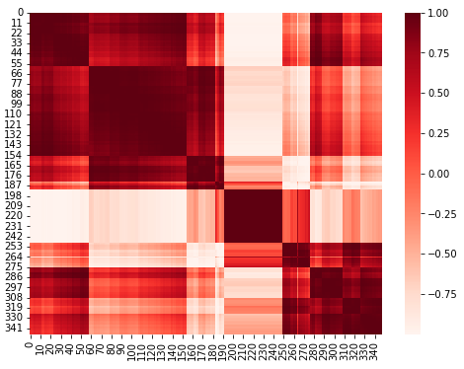
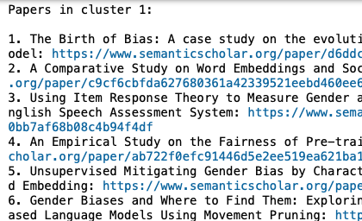
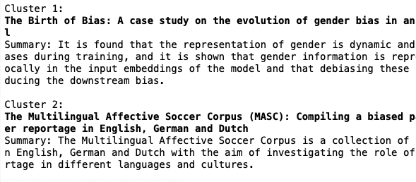
Project Overview – My Contributions
Embedding Visualization Tool
Web tool that makes it easier to analyze large collections of documents
Analyze similarities and differences between types of embeddings (Specter, Specter 2, SciNCL, etc)

Slide 8
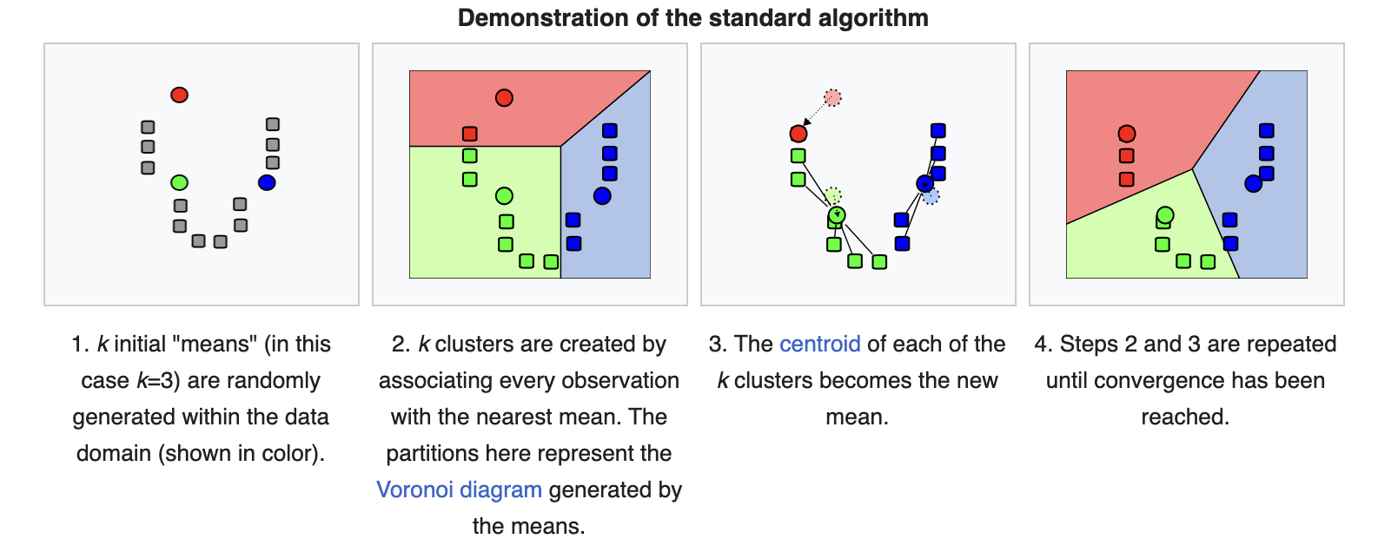
K-Means

Slide 9
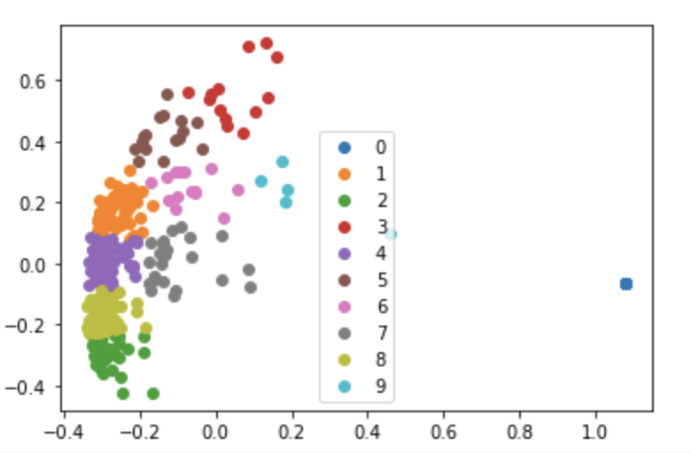
Project Overview – My Contributions
K-Means Clustering for Proposed

Slide 10
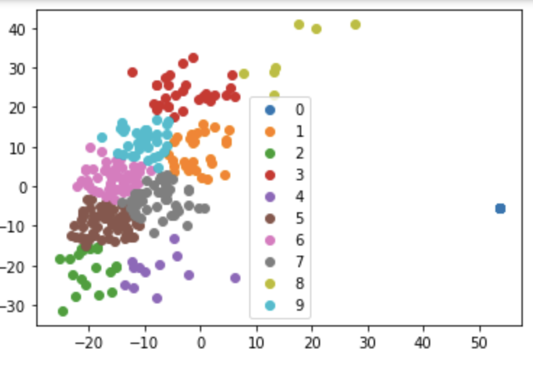
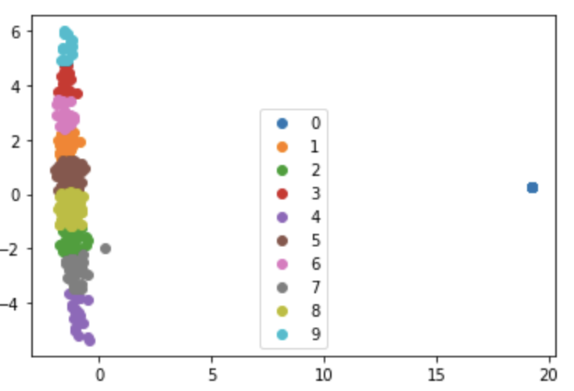
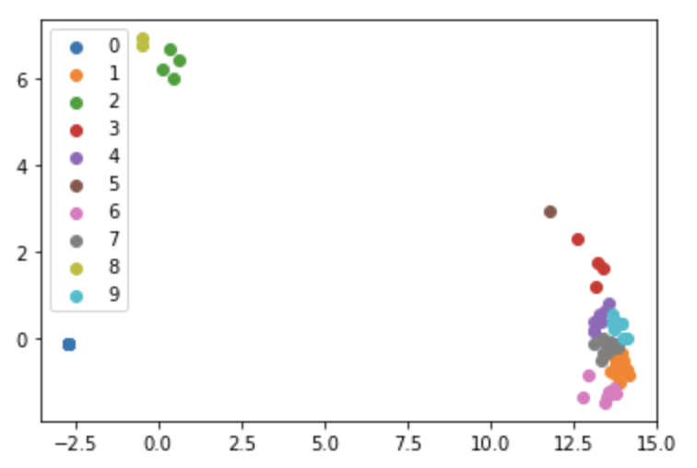
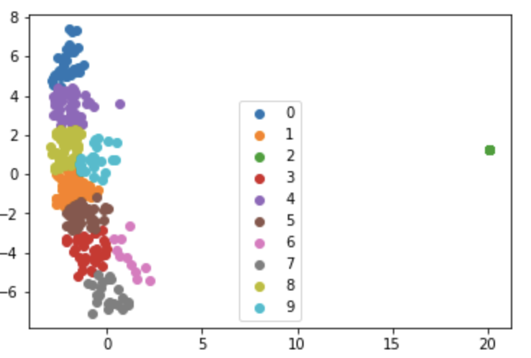
Project Overview – My Contributions
Specter
Specter 2
LinkBERT
SciNCL
Proposed

Slide 11
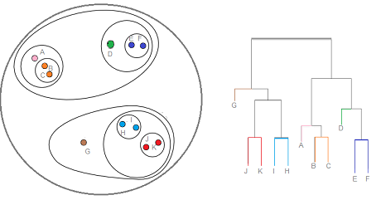
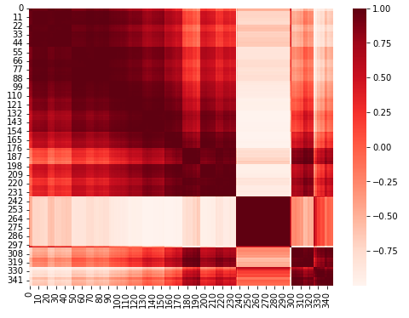
Hierarchical Clustering (Agglomerative)
Small Example

Slide 12
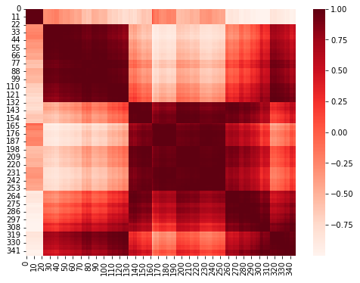
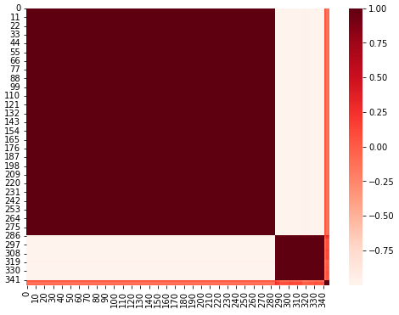
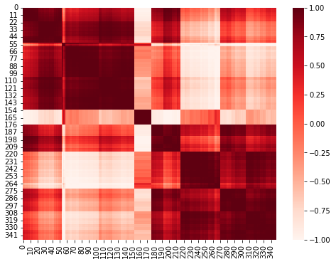
Project Overview – My Contribution
Specter
Specter 2
LinkBERT
SciNCL
Proposed

Slide 13
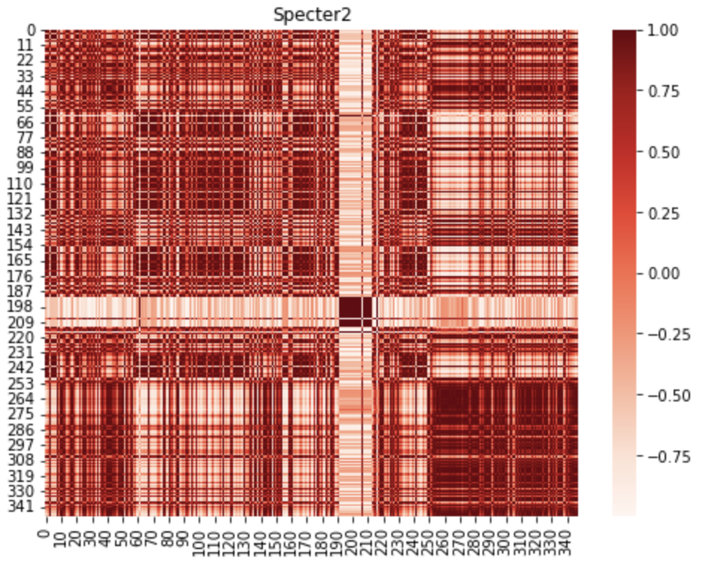
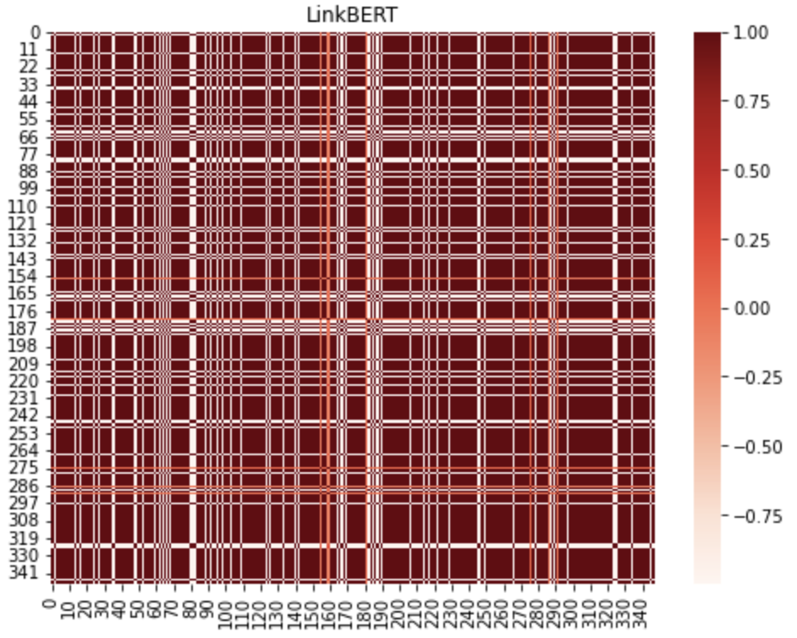
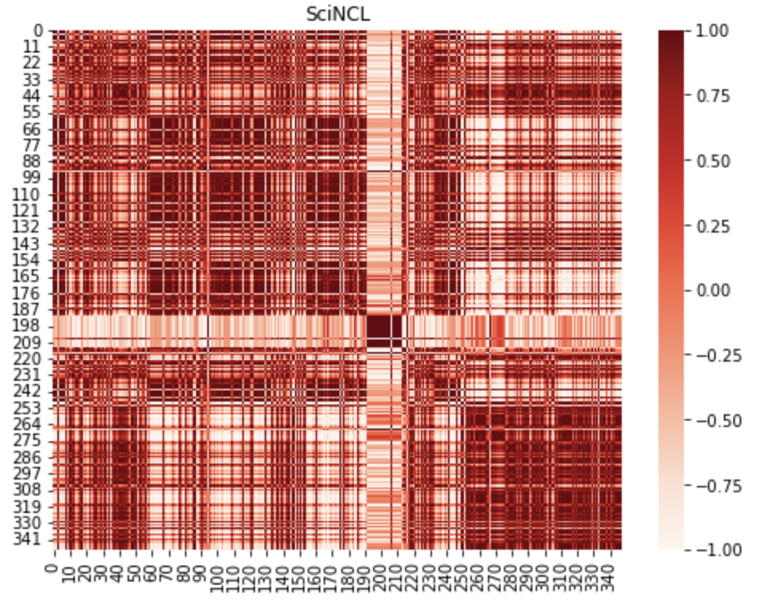
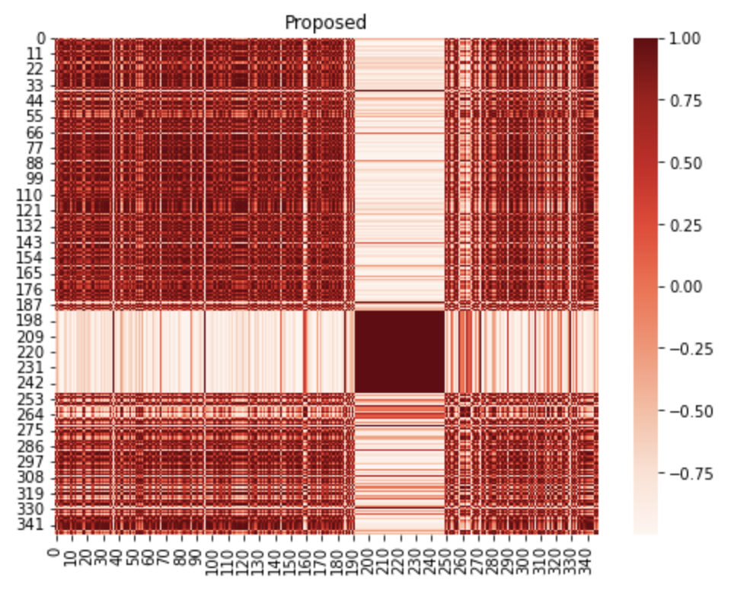
Project Overview – My Contributions
Specter
Specter 2
LinkBERT
SciNCL
Proposed

Slide 14
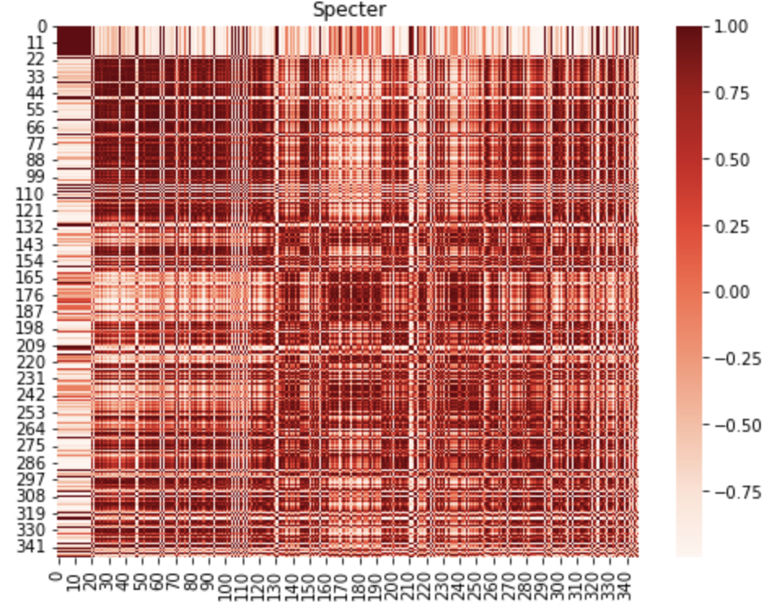
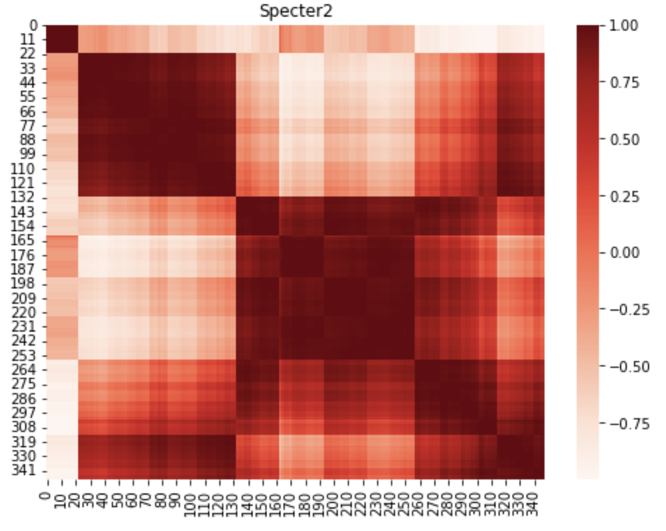
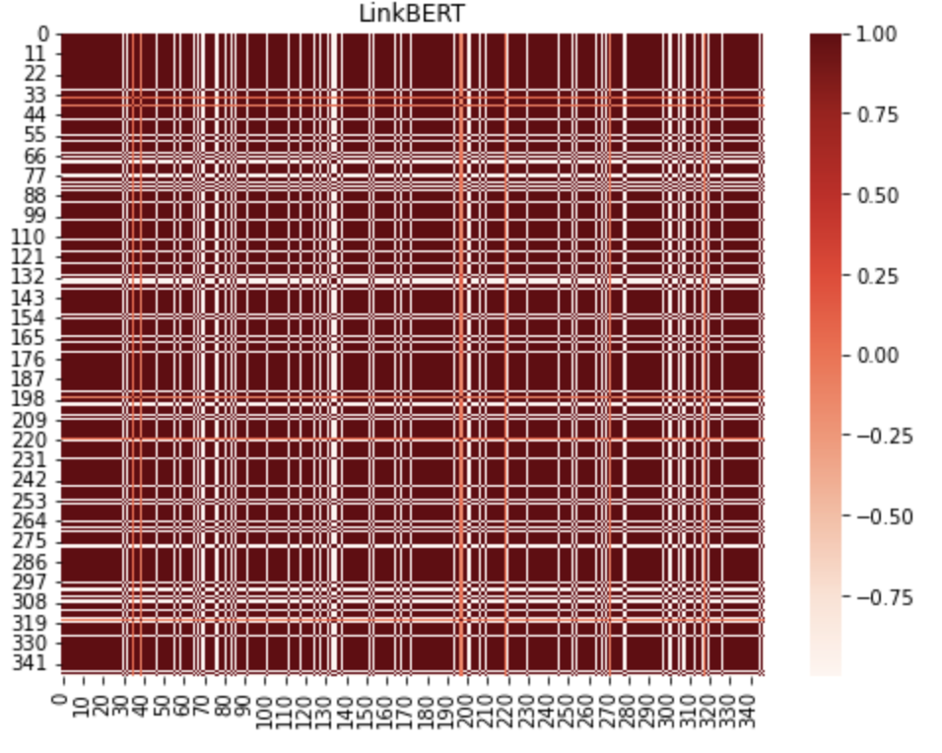
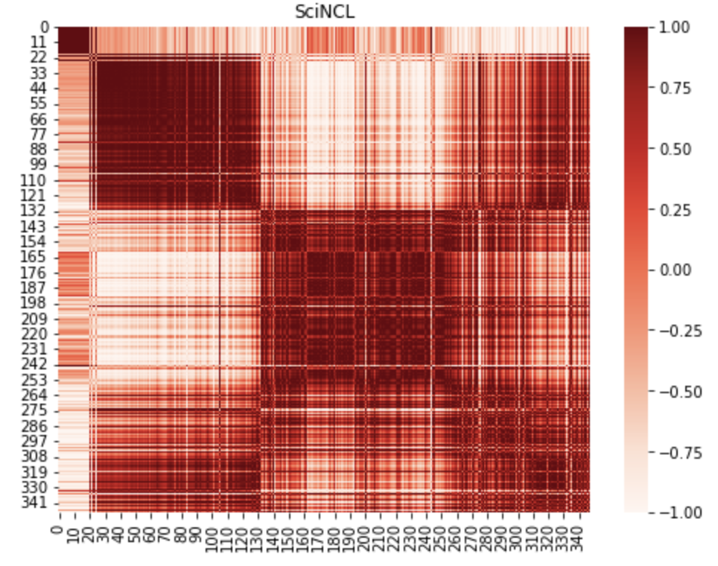
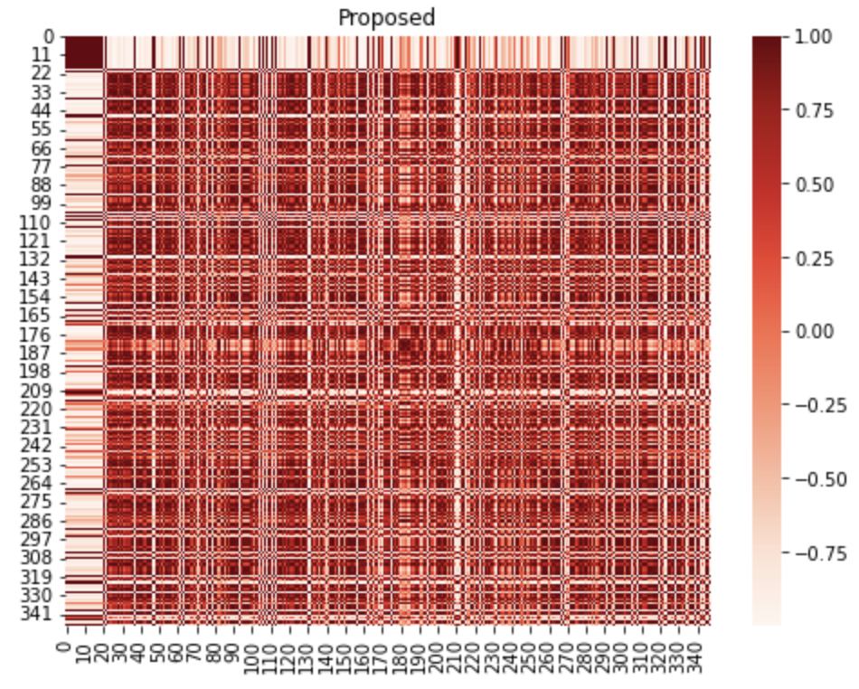
Project Overview – My Contributions
Specter
Specter 2
LinkBERT
SciNCL
Proposed

Slide 15
Project Overview – My Contributions
Evaluation
Get cumulative citation counts for each year for the task of citation count prediction after k years
N x K matrix
N is approximately 270m for all papers, K is 340 years
Each entry represents a paper being cited in the corresponding year
Use most recent citation graph

Slide 16
Project Overview – Next Steps
Evaluation
Will be assigned projects to work on to support development of tasks and metrics
Paper collection analysis
Convert Jupyter Notebook into more user friendly format, web UI
Generalize to work for any collection of papers
Understand clusters in more depth
Compare / contrast clustering of different embeddings of same documents
Consider papers from varying distances from centroid
Does the closest one represent the cluster well? How to better represent and understand each cluster?
How does the k-means result compare to the hierarchical ordering?

Slide 17
Questions?

Slide 18
Thank you!

